Slide 1

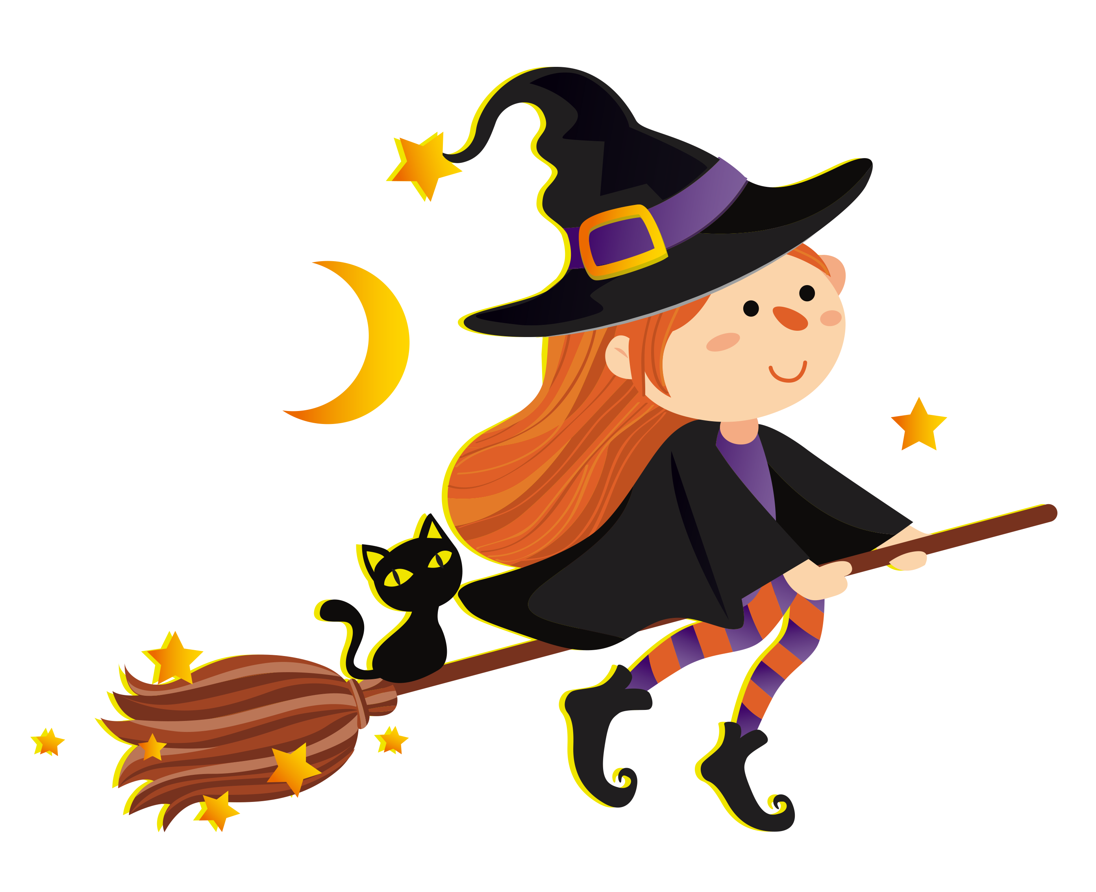
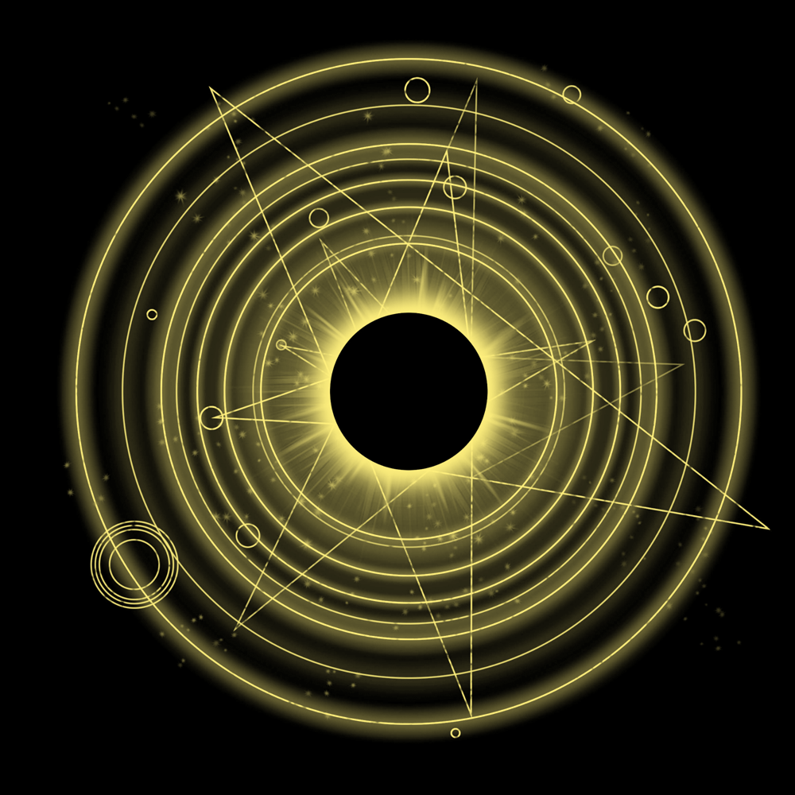
Taro Master Report

Slide 2
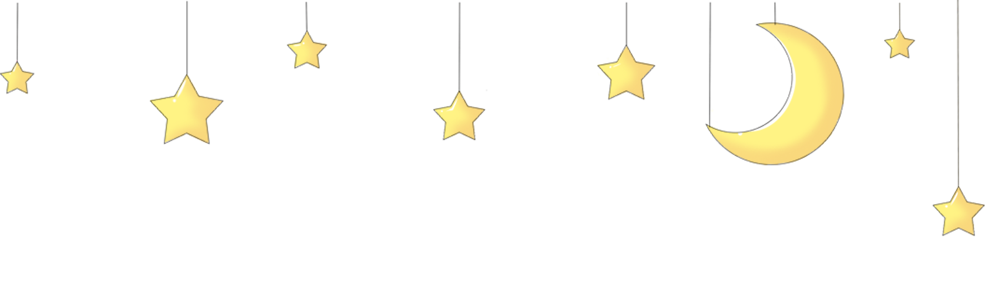
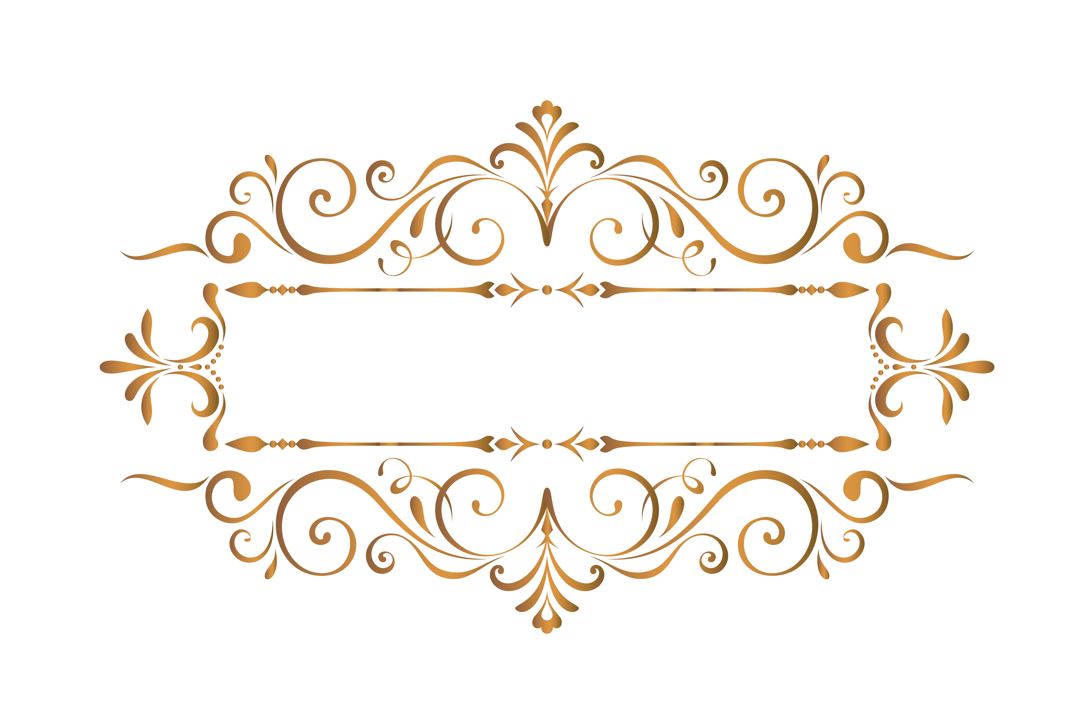
Overview
Ah, the cards have spoken! Let's see what they have to say about your question. The Justice card symbolizes balance, fairness, and accountability. It indicates that decisions will be made based on what is right and just. In the context of your question, it suggests that there will be a need to weigh the pros and cons of rekindling the relationship with your ex. The Hierophant card represents tradition, conformity, and spiritual guidance. It could suggest seeking advice from a wise authority figure or following conventional wisdom in matters of the heart. Perhaps it's a sign to reflect on the lessons learned from the past relationship before moving forward. Lastly, the Hanged Man card symbolizes surrender, letting go, and gaining new perspectives. It could indicate that a period of introspection and sacrifice is needed before making a decision about reuniting with your ex. Sometimes, in order to move forward, we must first release attachments to the past. Overall, the cards seem to suggest that reconciliation with your ex may be possible, but it will require careful consideration, guidance from others, and a willingness to let go of old patterns. If both parties are willing to work towards a healthier and more balanced relationship, then there may be a chance for reconciliation in the future. Remember, the choice is ultimately yours to make. So, keep an open mind, listen to your intuition, and trust that the universe will guide you towards the right path for your heart. Good luck on your journey of love and self-discovery!

Slide 3
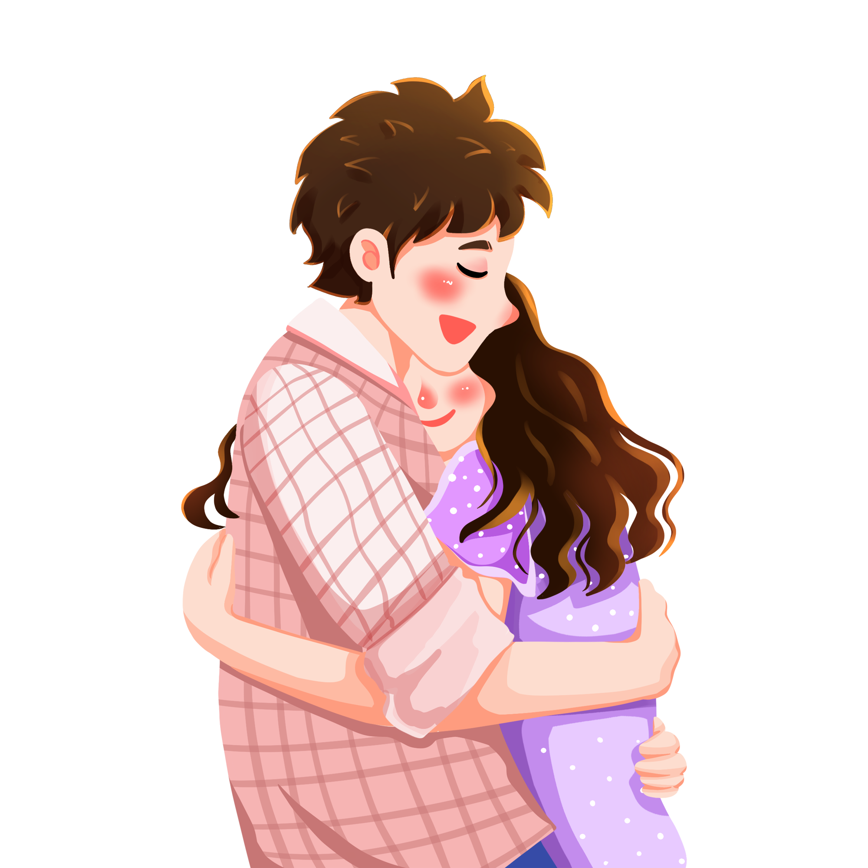
Love
Ah, love is in the cards for you! With Justice, Hierophant, and Hanged Man drawn, it looks like your love life is about to take an interesting turn in the next one to three months. Justice symbolizes balance and fairness, indicating that any relationship issues or conflicts will be resolved with honesty and integrity. This could mean finding closure with a past love or finally getting the closure you need to move forward. The Hierophant suggests a period of spiritual growth and learning within your relationships. You may find yourself drawn to someone who shares your beliefs and values, deepening your connection on a spiritual level. This card also represents tradition and commitment, so this could be a time when you're looking for a more serious, long-term relationship. The Hanged Man indicates a temporary pause or sacrifice in your love life. You may need to let go of old patterns or beliefs that are holding you back from finding true love. This could be a period of self-reflection and introspection, allowing you to see things from a different perspective and make necessary changes. Overall, these cards indicate a period of growth, balance, and introspection in your love life. Stay open to new possibilities and be willing to make the necessary sacrifices to find the love and connection you desire. Keep an open heart and mind, and trust that the universe has a plan for your romantic future. Love is on the horizon, so be ready to embrace it with open arms!

Slide 4

Career
Ah, the cards have spoken! Justice, Hierophant, and Hanged Man. Let's see what the universe has in store for your career in the next one to three months. Justice indicates that fairness, balance, and proper decision-making will be key factors for you in your career during this time. It suggests that any legal matters or contracts will be resolved in your favor, bringing about a sense of equilibrium and justice in your work life. The Hierophant suggests that tradition, learning, and guidance will play a significant role in your career path in the upcoming months. Perhaps you will seek out a mentor or engage in further education to enhance your skills and knowledge. This card also signifies a period of conformity and following established rules, indicating that sticking to the tried and true methods will be beneficial for you. The Hanged Man urges you to take a different perspective on your work situation. It may be time to step back, let go of old ways of thinking, and embrace a new approach or outlook. This card often signifies a period of suspended action or feeling like you are in limbo, but remember, sometimes hanging upside down can offer a whole new perspective on things. Overall, these cards suggest that the next one to three months will be a time of seeking balance, learning from tradition, and embracing new perspectives in your career. Stay true to yourself, trust in the process, and don't be afraid to see things from a different angle. Good luck on your career journey!

Slide 5

Finance
Ah, the cards have spoken! Let's see what the future holds for your financial situation in the next one to three months: Justice represents balance and fairness in financial matters. This card suggests that your past actions will have a direct impact on your financial situation in the coming months. It's time to make decisions based on logic and reason, as well as consider any legal or contractual matters that may arise. The Hierophant symbolizes tradition and education when it comes to finances. This card advises you to seek advice from a financial expert or mentor to guide you on the right path. It may also indicate the need to adhere to established financial principles and practices to achieve stability and growth. The Hanged Man suggests a need for sacrifice and a new perspective on finances. You may need to let go of old financial habits or beliefs that are holding you back from achieving your goals. This card challenges you to look at your finances from a different angle and make necessary adjustments for long-term success. In summary, the cards indicate that you will need to find a balance between past actions, seek guidance from experts, and adopt a new perspective on finances in the next one to three months. Stay open-minded and be willing to make changes as needed to improve your financial situation. Good luck!

